Slide 1







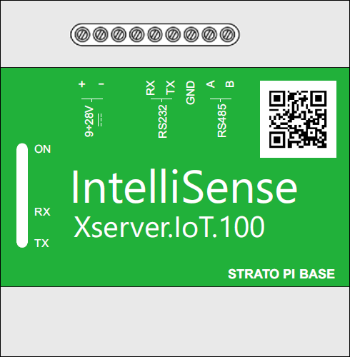

- Interval log (fastest 1 second, typical setting is 1 minute or 15 minutes)
- Change of value log
- Alarm log
- Event log (fails and status of the Xserver.IoT device)
IoT Hub
Machine learning
Database
MQTT, AMQP
Xserver.IoT device with onboard storage
RS485 Modbus RTU
External application
Electrical meters

Slide 2



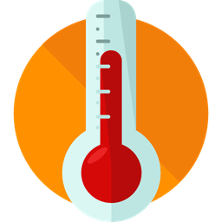
Heat meter
Ethernet Switch
Modbus TCP/IP
Temperature meter
RS485 Modbus RTU
Electrical meters

Slide 3
EMS, BMS, ERP, MES system
Local SQL Server
Heat meter
Ethernet Switch
Modbus TCP/IP
Temperature meter
Xserver.IoT device with onboard storage
RS485 Modbus RTU
Electrical meters

Slide 4

EMS, BMS, ERP, MES system
Heat meter
Ethernet Switch
Modbus TCP/IP
Temperature meter
Xserver.IoT device with onboard storage
RS485 Modbus RTU
Electrical meters

Slide 5




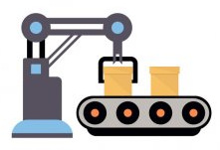
IoT Server
Electrical, Gas, Water meters …
Temperature sensors ...
Production data ...

Slide 6


IoT Server
Modbus TCP/IP
Modbus RTU
Modbus RTU
PLC
Production data ...
Production data ...
Production data ...

Slide 7




Site Manager
Central Management
Xserver.IoT Gateway
Alarm email
Electrical, Gas, Water meters, PLCs, etc.
Engineer
Electrical, Gas, Water meters, PLCs, etc.

